Slide 1
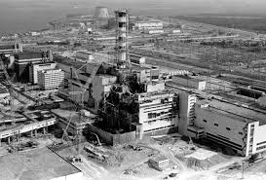
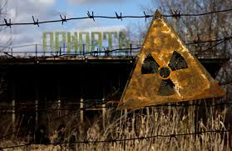
The Chernobyl Meltdown
Jon Jostad

Slide 2
What is Chernobyl?
Chernobyl was a nuclear power plant in Ukraine
The first reactor was completed in 1977
It’s located about 16 km from the border od Belarus and Ukraine
The fourth reactor was finished in 1983

Slide 3
What happened?
At the time of the accident the 5th and 6th reactors were under construction
On April 26, 1986, during a routine systems check there was a sudden power surge
An attempt for emergency shutdown failed, and there was another secondary surge that ruptured a reactor vessel
Which lead to a series of explosions

Slide 4
What happened? Cont.
This exposed the Graphite Moderator, it quickly ignited
The ignition sent a large plume of fallout into the atmosphere
The fallout spread out across Russia, Ukraine, Belarus, and other Eastern European countries

Slide 5
What’s next?
Over 500,000 were exposed to the deadly radiation, which can cause cancer, birth defects, and many other problems
The radiation will remain in the area for millions of years
It will never really go away

Slide 6
Sources
http://en.wikipedia.org/wiki/Chernobyl_disaster
http://en.wikipedia.org/wiki/Chernobyl_Nuclear_Power_Plant

