Slide 1
Controlling robots with our minds?
By: Mike & Matt

Slide 2
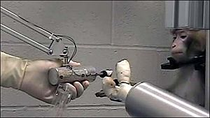
Fiction or reality?
Controlling a robot with your mind is considered to be the stuff of science fiction novels, not reality. However, University of Pittsburgh professor and neuroscientist Andrew Schwartz has been studying and publishing how the brain can control an external arm and hand since 2006.

Slide 3
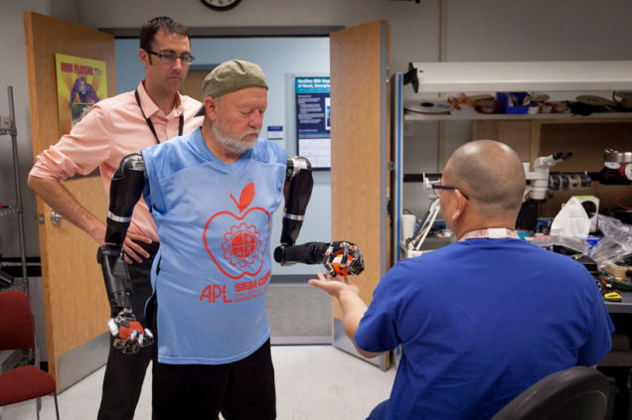
Robotic Body Parts
Many robotic body parts are in use today. As reported by Susan Young at the MIT Technology Review, a woman is paralyzed from the neck down is using an advanced brain-computer to operate a robotic arm. In a video, she is seen moving the robotic arm with the same range of motion as a human arm.

Slide 4
Cons
It takes long hours to train a person to be able to control the body parts
You can only move one join at a time where in human arms we can move all of them at the same time.
They are extremely expensive

Slide 5
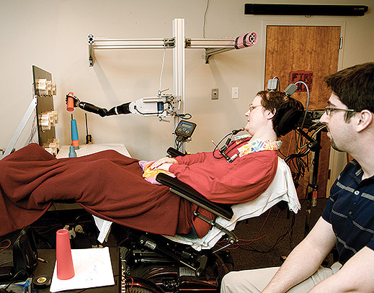
Pros
War veterans will be able to regain missing limbs
People born without certain limbs will be able to have them
People who have become paralyzed can have an arm they can control.

Slide 6
Bibliography
http://gizmodo.com/holy-crap-this-guys-got-two-mind-controlled-robot-arms-1673271601
http://www.technologyreview.com/featuredstory/528141/the-thought-experiment/

