Slide 1
Flesh Eating Bacteria
By Riley Schafer and Jameson Meyer

Slide 2
How you get it
The bacteria can go through any open wound, insect bites, or abrasions.
You can also get it after surgery or an injury.
The bacteria starts working once it infects a connective tissue below the skin.

Slide 3
Symptoms
Pain increases by the wound
Pain that is worse than expected
Warmth and redness around the wound
There can be flu-like symptoms
Dehydration
1 in 4 die from this infection

Slide 4
Different Cases
3 deaths, 13 hospitalizations in a Florida ocean
Two kids got the infection in Sarasota County, Florida after swimming. One died.
A dozen cases in Monroe County, Florida
A man had his arm amputated in Gulfport, Mississippi.

Slide 5
Will you get it?
Most likely not. If you are healthy, have a strong immune system, and practice good hygiene, the chances of you getting this disease are extremely low. Only 2 in a million people get this disease each year.

Slide 6
Disclaimer
The following slide contains graphic images that cause weak stomachs to feel nauseous. Viewer discretion is advised.

Slide 7
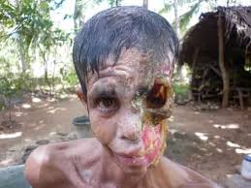
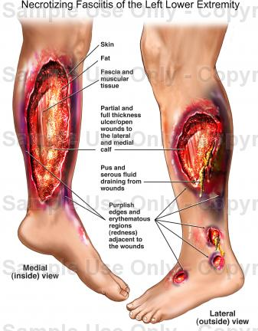

Slide 8
Sources
Flesh-eating bacteria: Vibro Vulnificus in Florida ocean …
Necrotizing Fasciitis (Flesh-Eating Bacteria): Causes …
2 cases of flesh eating bacteria in Sarasota
https://www.pinterest.com/wright760/fascinating/
Flesh-eating bacteria cases at Rochester General
http://www.cdc.gov/features/necrotizingfasciitis/
http://www.healthlinkbc.ca/healthfiles/hfile60.stm

