Slide 1
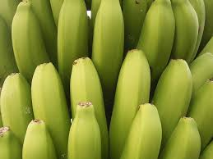
Bananas anonymous By Bridget Knudtson
Why bananas cant sexually reproduce and what happened to Big Mike

Slide 2
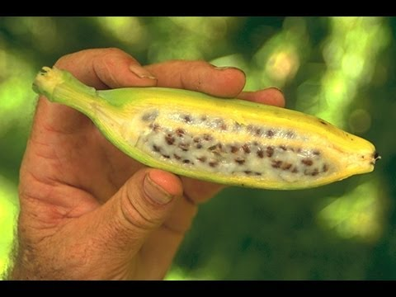
So bananas aren’t natural?
Yes they are. They first appeared naturally as a fruit with a clump of hard, inedible seeds in Southeast Asia.
Mutants with seedless, soft fruit, started to appear and hunter-gatherers liked those best.

Slide 3
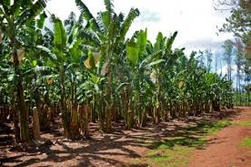
What happened?
Farmers started to grow this banana using cuttings.
Eventually, all bananas were farmed this way using bananas that could not reproduce on their own.

Slide 4
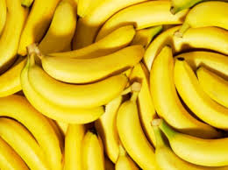
Im eating clones?
Pretty much. Technically all bananas that exist in agriculture today are descendants of the first bananas planted.
Without sexual reproduction, there is no genetic variation and the bananas remain the same.

Slide 5
What does this mean?
Eating banana clones may not seem bad, but it exposes the crop to mass extinction because they now lack the ability to fight off diseases. Without mutants, everyone either lives or dies.
Genetically Engineering bananas is incredibly expensive and time-consuming.

Slide 6
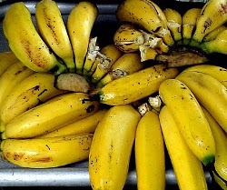
Big Mike
A banana mass extinction has happened before. The main type of banana sold worldwide was the Gros Michel banana.
But in the 1950s a soil fungus known as Panama disease all but wiped out the population.

Slide 7
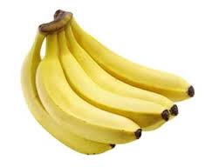
What now?
Now, the main type sold is called the Cavendish.
It has already been threatened by diseases and is very vulnerable.
If the banana does die, it could spell immense economic trouble and many could starve.

Slide 8
Sources
http://commons.wikimedia.org/wiki/File:Banana_plantation_(La_Cuesta)_03_ies.jpg
http://conservationmagazine.org/2008/09/the-sterile-banana/
http://i.ytimg.com/vi/vKOSMnKWb8M/hqdefault.jpg
www.moaliberia.org
http://angrytrainerfitness.com/wp-content/uploads/2012/08/bananas.jpg
http://upload.wikimedia.org/wikipedia/en/7/72/Gros_Michel_Bananas.jpg
http://www.woolworths.com.au/wps/wcm/connect/a7021f96-acaf-4710-9722-4f1179512896/cavendishbananas.jpg?MOD=AJPERES&CACHEID=a7021f96-acaf-4710-9722-4f1179512896

