Slide 1
Avian Bird Flu in South Dakota
By: Dillon Jensen
Date: 5/18/2015

Slide 2
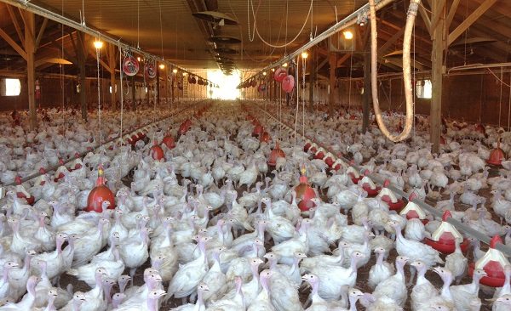
What Is Avian Flu?
It is infectious viral disease. Humans are not usually hurt by this. It is more common known as bird flu. H5N1 is bird flue that can kill people and any other mammal that gets infected from a bird. It killed 60% of people that were infected by it. The birds that are affected will most likely die in 48 hours. It is spread by saliva and manure. Also will spread if the infected bird drinks out of the same water as healthy birds.

Slide 3
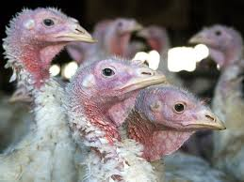
Symptoms
Ruffled feathers
Lay fewer eggs
Extreme fatigue
Dry cough
Runny and stuffy nose
Stomach Symptoms

Slide 4
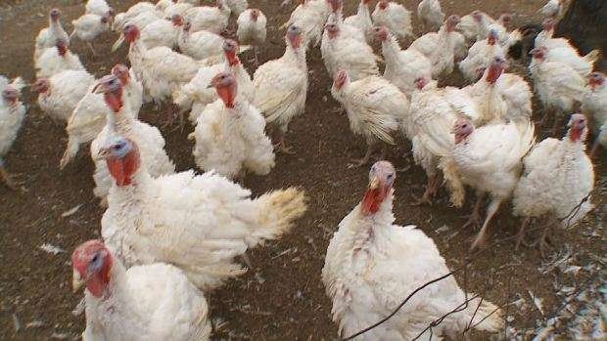
Preventions & Treatments
Don’t move to infected areas.
Avoid farms
Avoid domesticated birds
Avoid Market places
Avoid raw eggs
Keep clean
Get medication if you get the disease
Talk to your doctor about possibly keeping healthy after being around the virus.

Slide 5
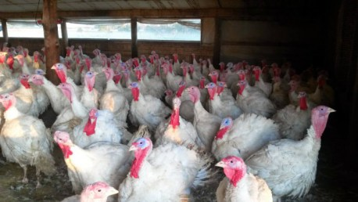
Video
https://www.youtube.com/watch?v=3GAg7pSPJw4

Slide 6
Bibliography
http://www.webmd.com/cold-and-flu/what-know-about-bird-flu
http://www.sdbirdflu.org/
www.argusleader.com
https://cbsminnesota.files.wordpress.com/2011/11/ferndale-market3.jpg?w=620&h=349&crop=1
https://bringmethenews.files.wordpress.com/2014/11/turkeys-e1427766107700.jpg?w=458

