Slide 1
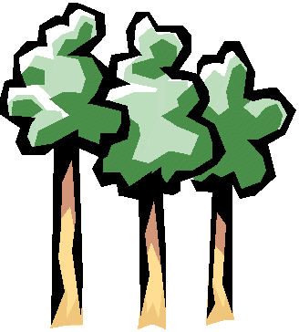
HOW MANY BEARS
CAN LIVE IN THIS WOODS?
http://www.gifs.net
http://www.uphs.upenn.edu/ifem/TREES.gif

Slide 2
You are a bear living in a forest.
You must get enough food every day to stay alive.
You get food by competing with other organisms in the forest.
Move around the “ecosystem”. Find a source of food. Compete with other “bears” by rolling dice. High roll wins ONE food ticket. Try to get a balanced diet by collecting a variety of foods (Different colors of tickets)

Slide 3
SPECIAL BEARS
Some bears have “issues” that complicate their ability to find and collect food.
Mother bear: Must get enough food for herself AND HER TWO CUBS. (You need double the tickets)
Injured bear: Has harder time getting to food. (You must beat the number rolled by your opponent by 2! ) Ex: Injured bear rolls a 6. Other bear rolls a 5…. OTHER BEAR WINS

Slide 4
80 lbs of food/bear TOTAL FOOD POINTS = _____ (Enough for ___ adults + 2 babies) Survivors = _____ Dead = _____ Did Mom survive? ____ Did babies survive? ____ Did injured bear survive? ____

