Slide 1
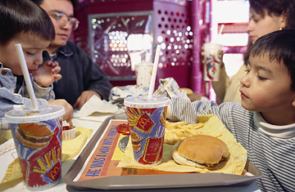
Epigenetics
Can “nuture” change “nature” ?
http://www.naturepedic.com/blog/wp-content/uploads/2010/11/BPA_free_logo.jpg
http://www.knowabouthealth.com/wp-content/uploads/2010/06/mcdonalds_.jpg
http://emilyscarenhealth.wordpress.com/2011/10/04/attention-a-must-read-for-smokers/

Slide 2
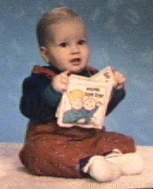
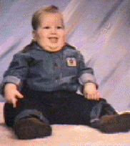
PRADER-WILLI Syndrome
Victor Age 1 Victor Age 2
Born floppy and pale At first refuse to nurse; later eat until they become obese
Tiny hands and feet Underdeveloped sex organs
Mildly retarded
Spectacular temper tantrums especially if refused food
Exceptional proficiency with Jig-saw puzzles

Slide 3
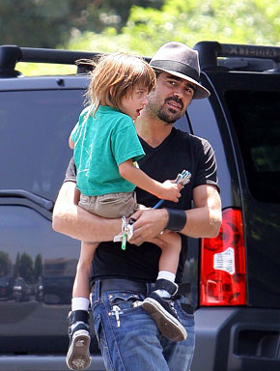
ANGELMAN’S SYNDROME
Taut, not floppy
Thin
Hyperactive
Insomniac
Small head
Move jerkily like puppets
Happy disposition
Severely mentally retarded
Colin Farrell’s son has
Angelman’s syndrome
Rarer than Prader-Willi
Missing SAME piece of Chromosome #15
http://www.usmagazine.com/colin_farrell_and_son

Slide 4
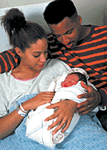
WHAT’S THE DIFFERENCE?
In Prader-Willi missing piece of #15 was from father
In Angelman’s, missing piece of #15 was from the mother
How does a gene “remember” where it came from?
_____________

Slide 5
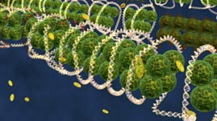
EPIGENETICS “above genetics” Molecules sit on top of the genome
Control which genes are ON or OFF
http://www.teachersdomain.org/assets/wgbh/biot09/biot09_vid_epigenetics/biot09_vid_epigenetics_l.jpg

Slide 6
Genes are “stamped” with an imprint during gamete production so same allele (maternal or paternal) is expressed in all body cells
Adding __________tags turns genes OFF
Removing tags turns genes ON
Several hundred mammalian
genes, many critical for
development, may be subject
to imprinting.
http://quest.mda.org/files/images/Quest_17_1_StoryPix/epigeneticmods_17_1_story2.jpg

Slide 7
Can our actions change our epigenome?
___
http://learn.genetics.utah.edu/content/epigenetics/inheritance/images/DirectExposure.jpg

Slide 8
Addition or removal or “methyl tags” may be influenced by environment
_________________
_________________
_________________
_________________
http://www.naturepedic.com/blog/wp-content/uploads/2010/11/BPA_free_logo.jpg
http://www.knowabouthealth.com/wp-content/uploads/2010/06/mcdonalds_.jpg
http://emilyscarenhealth.wordpress.com/2011/10/04/attention-a-must-read-for-smokers/

Slide 9
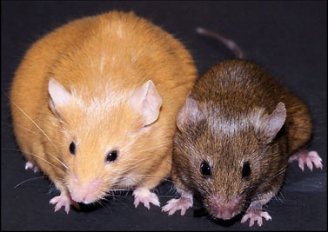
VIDEO
Twins start with same methyl tags but become more different with age
Agouti rats – changing diet of pregnant mom can change expression of genes
http://www.precisionnutrition.com/wordpress/wp-content/uploads/2009/12/Figure-3-Agouti-mice.jpg

Slide 10
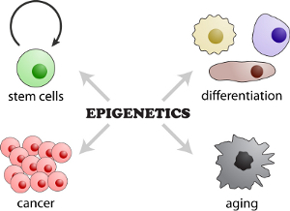
Epigenetics
_________________ chromosome tags
____________ in embryonic development
Changes in _______ , ________, ______
Differences can lead to diseases like ________ or ________________
http://www.molekularbiologie.abi.med.uni-muenchen.de/ueber_uns/schotta/index.html

Slide 11
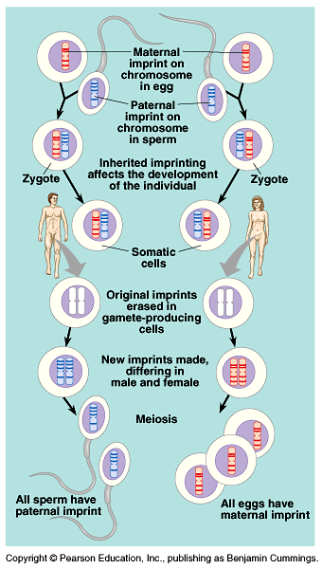
MATERNAL/PATERNAL TAGS
Gamete producing cells erase “old tags”
All chromosomes are reimprinted according to the sex of the individual in which they reside
Imprinting is critical for normal development.
Copyright © 2002 Pearson Education, Inc., publishing as Benjamin Cummings

Slide 12
DEVELOPMENT
http://3.bp.blogspot.com/-4OjTMIZFkkM/TZp8F6zXxII/AAAAAAAAAAg/C5NoNmKmA4M/s1600/epigenetics.jpg

Slide 13
DIFFERENTIATION
ALL body cells have same genes. DNA code is the same.
What makes them different is which genes are turned on or off.
Methyl tags turn genes off!
https://www.systembio.com/images/graphic_diffReport1.gif

Slide 14
X-chromosome Inactivation
X X X Y
In female cells ______ chromosome is randomly ________________
It condenses and forms a dense region in the nucleus called a
_____________
http://fig.cox.miami.edu/~cmallery/150/gene/barr.htm

Slide 15
CAT COLOR
http://www.islandstrolling.com/mainland/peloponnes/photo/mystra_cat_white_orange_black.jpg
In cats, a gene that
controls the _____________
is carried on the
_________________
In some female cells the X with the allele for orange spots
is switched off and in some cells the X with the allele for
black spots is switched off, so cat has different
colored spots.
See a video

Slide 16
CAT COLOR
http://ascensionparish.net/forum/messages/14/2493.jpg
_________ cats have only
one X chromosome, so they
can only have
____________ of spots!
THINK ABOUT IT?
How many colors of spots could a male cat with
Klinefelter syndrome have?

Slide 17
LINKS TO CANCER
BRCA =
tumor suppressor gene
If it’s turned OFF
cancer cells are NOT
repaired and can grow
into a tumor
http://www.landesbioscience.com/journals/epigenetics/

Slide 18
SO WHAT?
It’s not just a MOM thing
Epigenetic therapy in future ????
How does what you do affect your kids’ and grandkids’ epigenome?
We are just beginning to understand . . .
http://www.naturepedic.com/blog/wp-content/uploads/2010/11/BPA_free_logo.jpg
http://www.knowabouthealth.com/wp-content/uploads/2010/06/mcdonalds_.jpg
http://emilyscarenhealth.wordpress.com/2011/10/04/attention-a-must-read-for-smokers/

