Slide 1
BANANA DNA EXTRACTION

Slide 2
Many plants are polyploids
Triploid (3n) crops: apple, banana, watermelon
Tetraploid crops (4n) apple, cotton, potato, peanut
Hexaploid (6n) crops: kiwi
Octaploid crops: strawberry, sugar cane, pansies
http://en.wikipedia.org/wiki/File:Haploid,_diploid_,triploid_and_tetraploid.svg

Slide 3
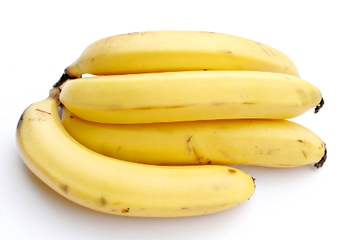
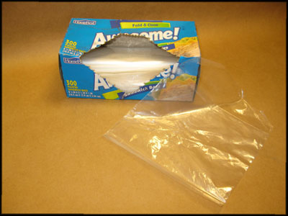
Place ½ of a banana in a plastic bag. Add 10 mL of distilled water. Squeeze bag to mash it up.
Crushing the bananas separates cells and hypotonic water helps them swell bigger.
http://www.skylighter.com/images/how_to/3-Inch-Plastic-Hybrid-Ball-Shell/Sandwich-bags.jpg
http://teachers.egfi-k12.org/wp-content/uploads/2011/01/Bananas.jpg

Slide 4
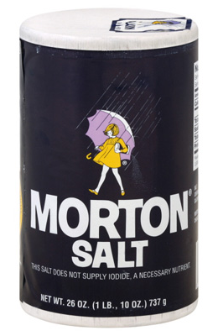
Use a plastic cup: Add 1 teaspoon of shampoo Add ¼ teaspoon of salt Stir to mix.
Stir GENTLY until soap and salt are dissolved. Avoid creating foam.
http://www.drugstore.com/suave-shampoo-aloe-and-water-lily/qxp2707
http://thumbs.dreamstime.com/z/soap-suds-bubbles-clip-art-2848674.jpg http://www.meijer.com/assets/product_images/styles/xlarge/1001029_024600010016_A_400.jpg

Slide 5
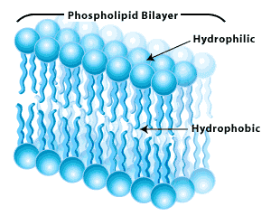
WHY?
http://qph.is.quoracdn.net/main-qimg-591994777746e06889e0ea0c87eb4da2?convert_to_webp=true
Adding salt (Na⁺Cl⁻) helps DNA molecules with NEGATIVE charges stick together.
Soap -helps break down cell membranes and release DNA
http://www.biologycorner.com/resources/lipidbilayer.gif

Slide 6
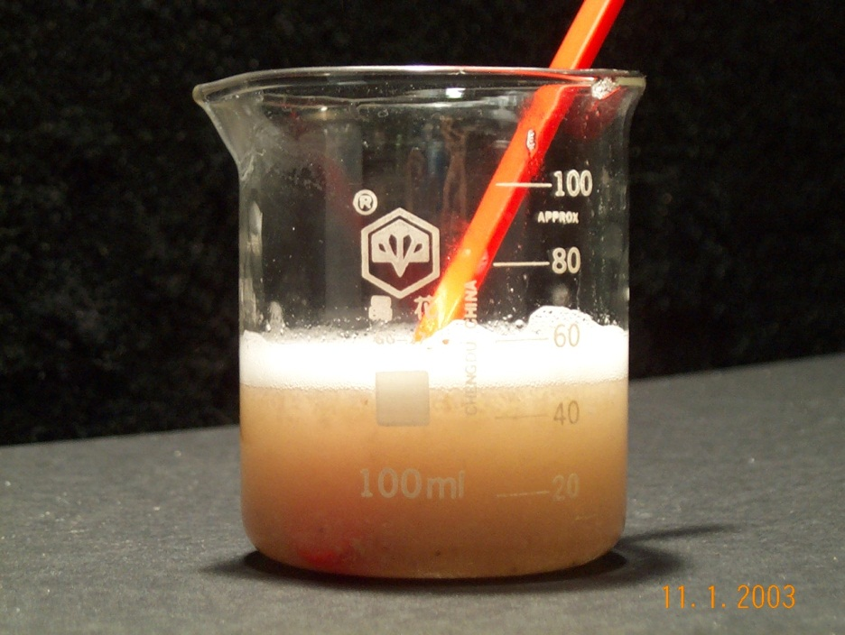
Add 2 spoons of the banana mixture.
Use spoon to stir GENTLY for at least 10 minutes.
http://www.odec.ca/projects/2003/britt3m/public_html/experiment.htm

Slide 7
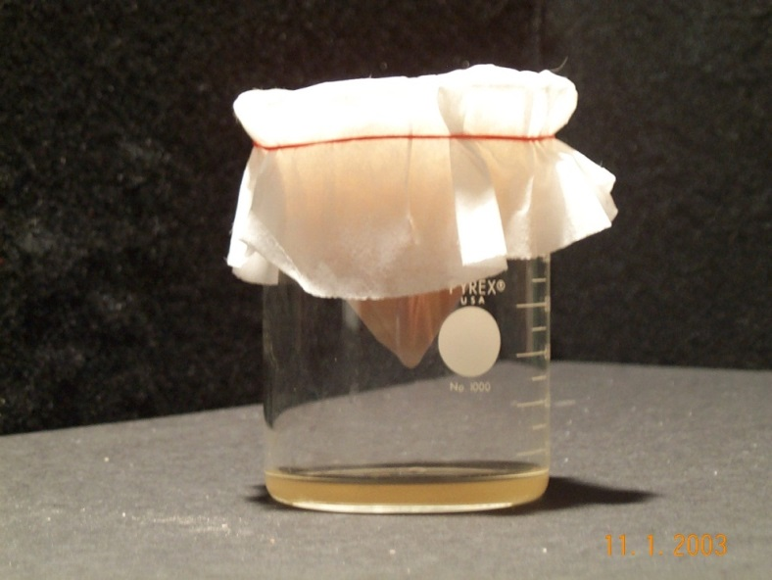
Add 20 mL water to mixture.
Place coffee filter into a the filter cone and hold it over a clean plastic cup.
Pour the banana mixture into the filter.
The liquid (called filtrate) will collect in the bottom of the cup.
http://www.odec.ca/projects/2003/britt3m/public_html/experiment.htm

Slide 8
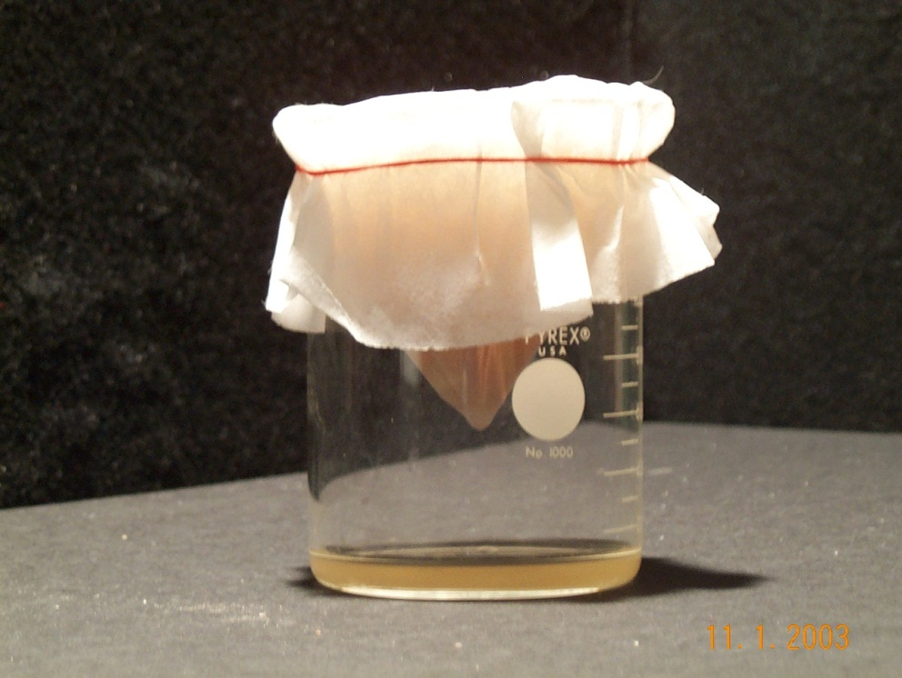
Gently stir the mixture in the filter being careful not to poke a hole in the filter paper.
Let sit for a few more minutes.
Remove filter and set aside.
http://www.odec.ca/projects/2003/britt3m/public_html/experiment.htm

Slide 9
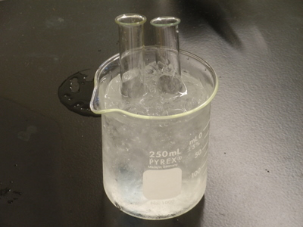
Obtain a tube containing 91% isopropyl alcohol. Keep the alcohol as cold as possible by placing it in the cup of ice.
http://depts.washington.edu/chem/courses/labs/162labs/images/PA030140.JPG

Slide 10
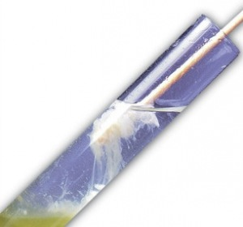
Use a pipette (eyedropper) to collect your filtrate and SLOWLY drop it down the inside of the tube containing cold alcohol. Add 2 droppers of banana filtrate. DON’T MIX THE LAYERS !
http://geneticmaize.files.wordpress.com/2011/09/window_testtube.jpg?w=300&h=280

Slide 11
Place tube on ice
Let sit UNDISTURBED for 4 minutes
Cold alcohol helps the DNA precipitate and come out of solution so it can be collected.
http://depts.washington.edu/chem/courses/labs/162labs/images/PA030140.JPG

Slide 12
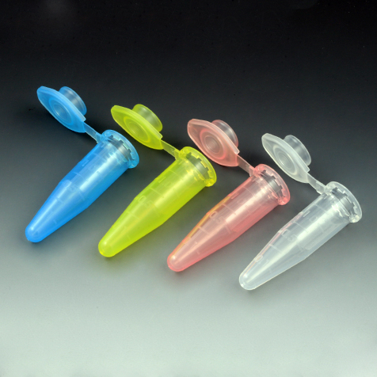
Dip the loop into the tube, slowly rotating it to spool out the banana’s DNA
Place in microtube containing alcohol.
http://geneticmaize.files.wordpress.com/2011/09/window_testtube.jpg?w=300&h=280 http://www.globescientific.com/images/111558.jpg

