Slide 1
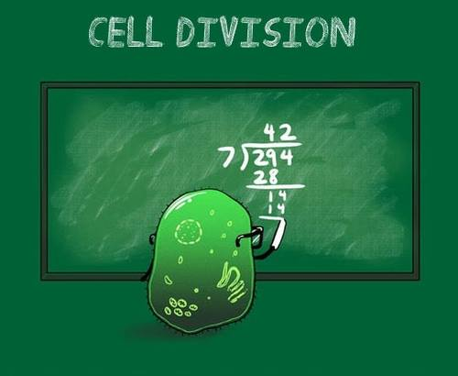
https://www.facebook.com/Carolina.Biological/photos/a.467232003653.259865.173476278653/10151636682028654/?type=1&theater

