Slide 1
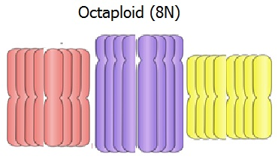
Many plants are polyploids
Humans (2n)
Triploid (3n) crops: apple, BANANA, watermelon
Tetraploid crops (4n) apple, cotton, potato, peanut
Hexaploid (6n) crops: kiwi
Octaploid (8n) crops: strawberry, sugar cane, pansies

Slide 2
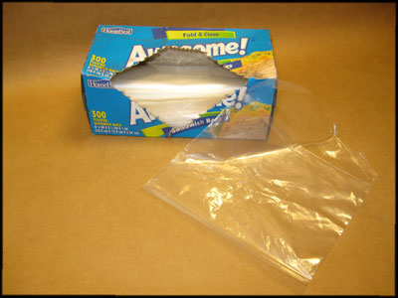
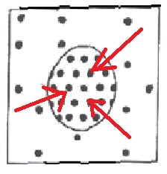
Crushing the bananas helps
separate cells
Hypotonic water helps cells swell bigger.

Slide 3
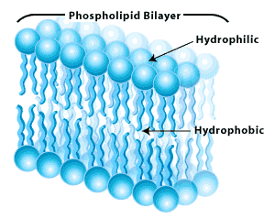
WHY?
http://qph.is.quoracdn.net/main-qimg-591994777746e06889e0ea0c87eb4da2?convert_to_webp=true
Adding SALT (Na⁺Cl⁻) helps DNA molecules with NEGATIVE charges stick together.
Soap -helps break down cell membranes and release DNA

Slide 4
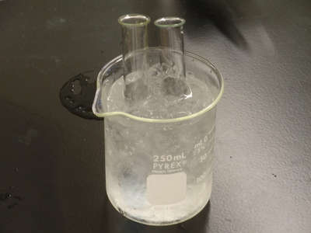
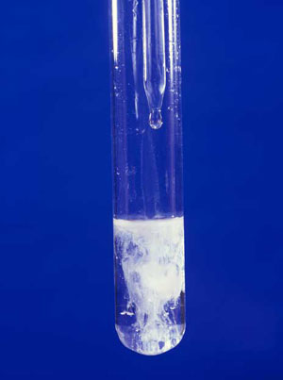
Cold alcohol helps
the DNA
precipitate
(come out of solution)
so it can be collected.

