Slide 1
Genetic Disorder Project

Slide 2
Genetic Counselor
Guides expecting parents through the chances of their child obtaining a genetic disorder
Provides information about the disorder and guidance through raising a child with a particular disorder

Slide 3
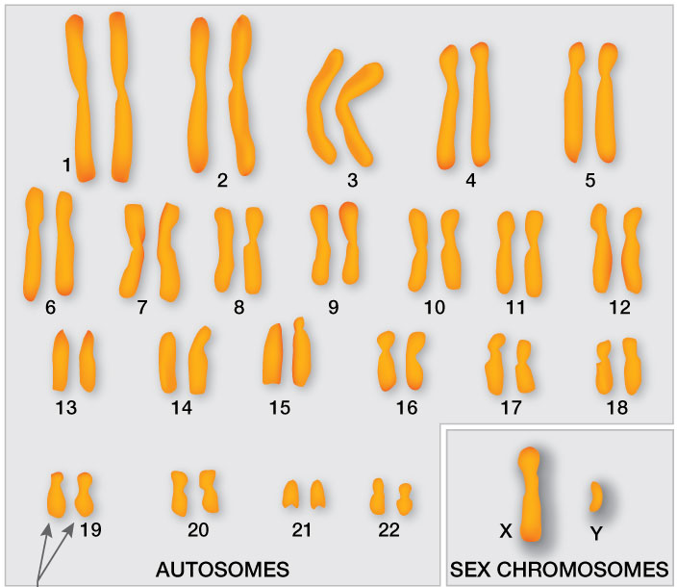
Autosomal Genetic Disorders
Mutation found on an autosome chromosome
Autosomes = all other chromosomes besides the 2 sex chromosomes
Autosomal disorder can be either Dominant or Recessive
Recessive (tt): A person must have both recessive alleles to have the disorder
Dominant (TT or Tt): A person needs at least one dominant allele to have the disorder

Slide 4
Autosomal Recessive
AUTOSOMAL DOMINANT
T
t

Slide 5
X-Linked Genetic Disorder
Mutation found on the X chromosome (Which is one of the two possible sex chromosomes)
REMEMBER:
Males = 1 “X” chromosome and 1 “Y” chromosome
Females = 2 “X” chromosomes

Slide 6
Males ONLY HAVE ONE X
DEFECTIVE
NORMAL
They either
have the
disorder
They don’t
OR

Slide 7
FEMALES HAVE TWO X CHROMOSOMES
NORMAL
DEFECTIVE
DEFECTIVE
Females have one normal gene that works.
Females need 2 defective recessive alleles to show the disorder

Slide 8
The X chromosome in males . . .
flies WITHOUT a copilot!
. . . there’s NO BACK UP X to help them!

Slide 9
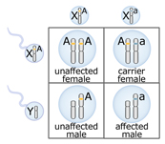
1 Unaffected Female
1 Carrier Female
1 Unaffected Male
1 Affected Male
What alleles would the parents have to have to produce an offspring that is an affected female?

Slide 10
Images from: http://www.bbc.co.uk/scotland/education/bitesize/higher/img/biology/genetics_adaptation/mutations/02gene_mutation.gif
KINDS OF MUTATIONS
Mutations that produce changes
in a single gene =
_________________
Mutations that produce changes
in whole chromosomes = _____________________
GENE MUTATIONS
CHROMOSOMAL MUTATIONS

Slide 11
DELETION: mutation caused by a DNA sequence getting removed or deleted

Slide 12
DUPLICATION: mutation caused by a DNA sequence getting copied and added into the DNA strand

Slide 13
INVERSION: mutation caused by a DNA sequence looping, breaking off, and reattaching backwards

Slide 14
SUBSTITUTION: DNA sequence is replaced by another sequence

Slide 15
Non-disjunction
Either the homologous chromosomes or sister chromosomes did not separate correctly during meiosis
RESULTS: Extra copies of a chromosome in some daughter cells and missing copies in another.

Slide 16
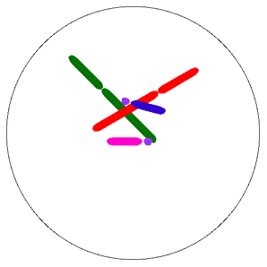
http://www.tokyo-med.ac.jp/genet/anm/mimov.gif
http://www.tokyo-med.ac.jp/genet/anm/domov.gif

