Slide 1
Trait Inventory

Slide 2
Detached VS. Attached Earlobes
Detached Earlobes
Attached Earlobes
http://wallpaper222.com/explore/unattached-earlobes/

Slide 3
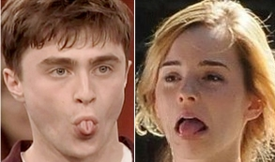
Roller Vs. Non-roller

Slide 4
Dimples
http://www.plasticsurgeryportal.com/articles/dimples-plastic%20surgery/300
https://en.wikipedia.org/wiki/Dimple

Slide 5
Freckles!
http://vaggelisfragiadakis.deviantart.com/art/they-call-me-freckles-100141340

Slide 6
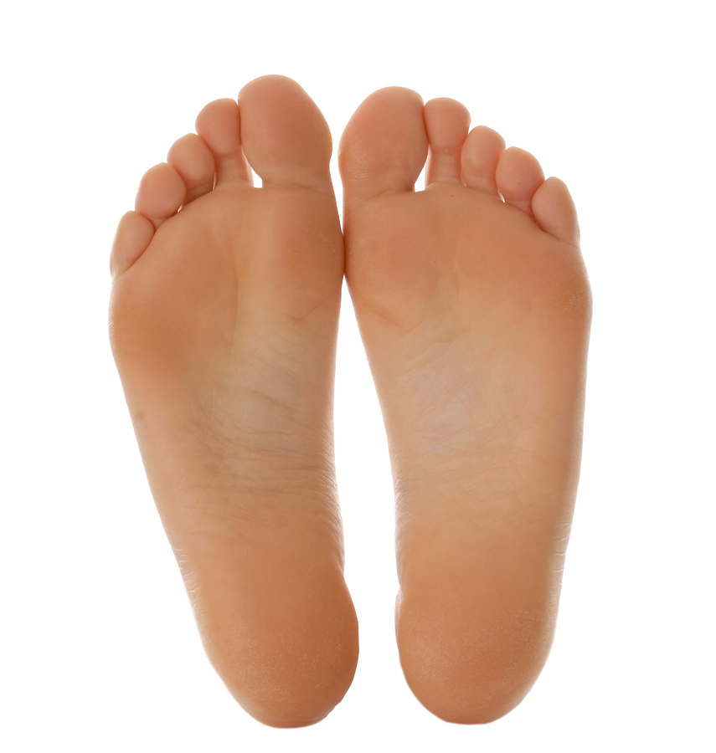
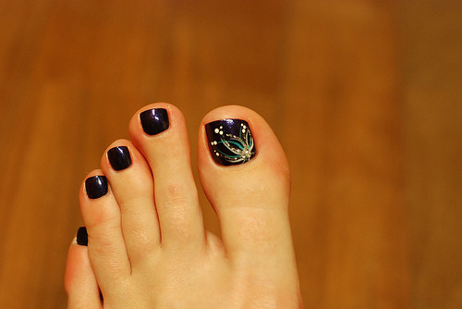
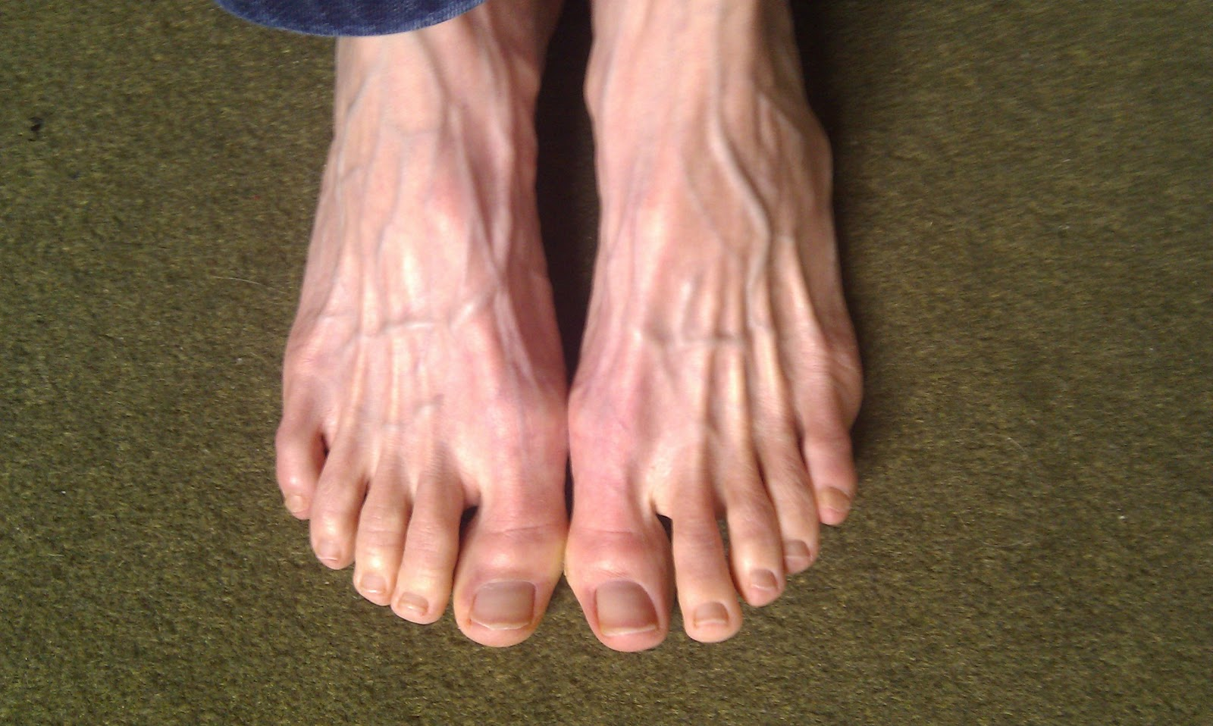
Longer 2nd Vs. Short 2nd
ourses.k12.sd.us

Slide 7
Cleft Chin vs Smooth Chin
Cleft
Smooth
http://s1.zetaboards.com/anthroscape/topic/5118413/1/
https://prezi.com/bibt934rwxze/pedigree-for-dimpled-chin/
https://www.pinterest.com/pin/388154061605313309/
http://notyouraveragestylewhim.blogspot.com/2014/10/know-your-skin-type-guys.html

Slide 8
Hitchhiker’s Thumb
http://www.sneezefetishforum.org/index.php?showtopic=45262

Slide 9
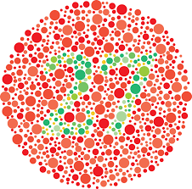
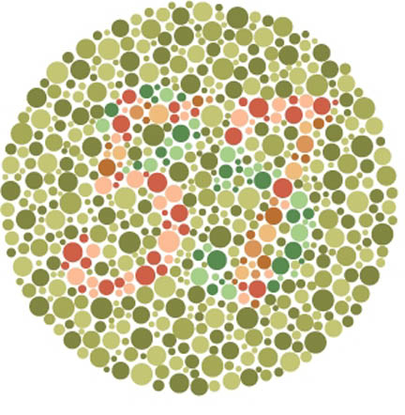
Color Blind

Slide 10
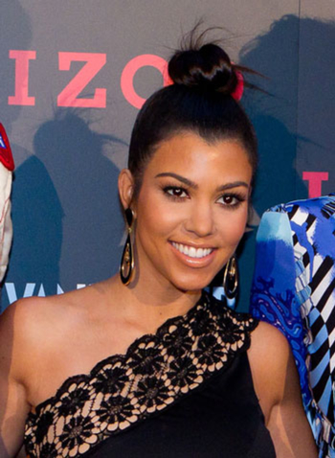
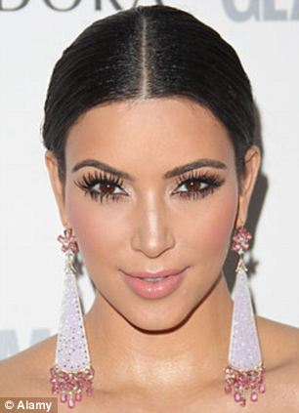
Widow’s Peak VS. Straight Hairline
Widow’s Peak
Straight Hairline
http://www.haringtons.com/news/hair-cuts-hairstyles-face-shapes/

Slide 11
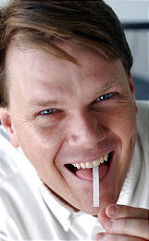
PTC
Phenylthiocarbamide
Determined by a single gene that codes for a taste receptor on the tongue
No taste VS. Bitter
http://www.rsc.org/chemistryworld/2013/10/phenylthiocarbamide-ptc-phenylthiourea-taste-genetics

