Slide 1
Blue People of Troublesome Creek

Slide 2
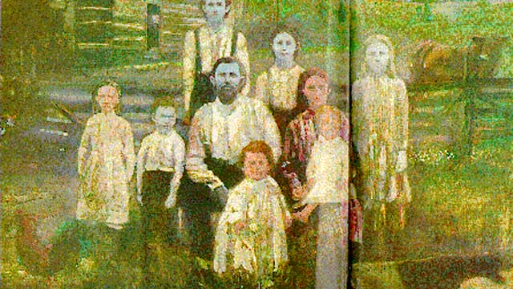
The Fugates Family

Slide 3
Martin Fugate
French orphan who came to America in 1820 and settled in an area known has Troublesome Creek, Kentucky
According to family written records he had blue tinted skin
For over the next 100 years Martin’s skin disorder was passed on through his descendants.
One of Martin’s sons married his maternal aunt and 100 years later Benjy Stacey was born (1975).

Slide 4
Methemoglobinemia
AUTOSOMAL RECESSIVE genetic disorder resulting in an abnormal amount of methemoglobin in the blood
Methemoglobin is a form of hemoglobin that can’t carry oxygen and effects normal hemoglobin from release it’s oxygen to the parts of the body
Methemoglobin Concentration | % Total Hemoglobin | Symptoms
<1.5 g/dl | 10% | None
1.5-3.0 g/dl | 10-20% | Cyanotic Skin Discoloration
3.0-4.5 g/dl | 20-30% | Anxiety, lightheadedness, headache
4.5-7.5 g/dl | 30-50% | Fatigue, confusion, dizziness
7.5-10.5 g/dl | 50-70% | Coma, seizures, arrhythmias, acidosis
> 10.5 g/dl | >70% | Death

Slide 5
How does the recessive trait continually get passed on?
GEOGRAPHIC ISOLATION
The Fugates along with a couple other families were isolated in Troublesome Creek, Kentucky. When the town was settled there were no roads, making it hard to get out.
Result of this was that people tended to intermarry.
By “LUCK” one of the other 2 families in the isolated town carried an allele for methemoglobinemia

Slide 6
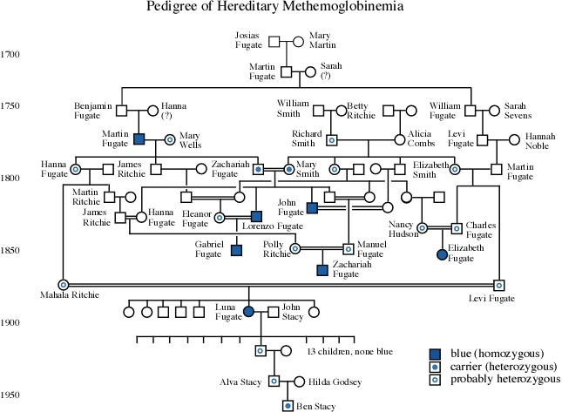

Slide 7
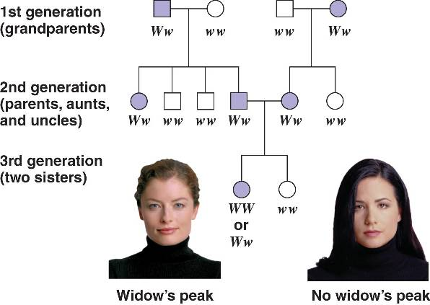
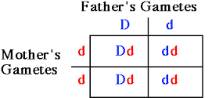
Punnett Squares VS. Pedigrees
Shows the probability of potential offspring between parents
Representation of a family tree that shows the inheritance of a genetic trait through generations

Slide 8
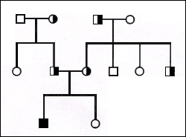
How to Read a Pedigree
Key
Homozygous Dominant Male
Homozygous Recessive Male
Heterozygous Male (Carrier)
Homozygous Dominant Female
Homozygous Recessive Female
Heterozygous Female (Carrier)
Parents
Parents are related to each other
A person that is HETEROZYGOUS for a trait is known as a
CARRIER
Offspring

Slide 9
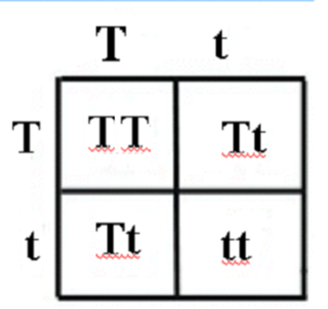
A CARRIER
A person that receives a recessive allele for a genetic trait or disorder, but doesn’t display or show the trait themselves.

