Slide 1
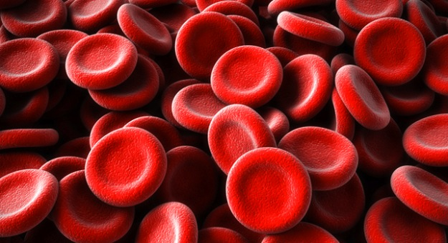
Blood Types

Slide 2
BLOOD TYPES have more than 2 allele choices = _________________________
REMEMBER:
MULTIPLE ALLELE TRAIT
The pattern of sugars that is attached is determined by genes
Allele choices are:
_____ ____ ____
A
B
O

Slide 3
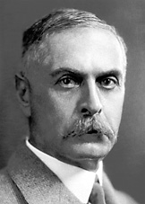
“AbO” System
An Austrian physician by the name of Dr. Karl Landsteiner won the Nobel Prize in 1930 for this system to classify human blood

Slide 4
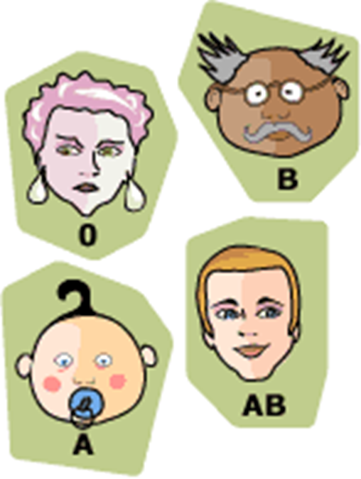
ABO blood grouping system
According to the ABO blood typing system there are four different kinds of blood types: A, B, AB or O.

Slide 5
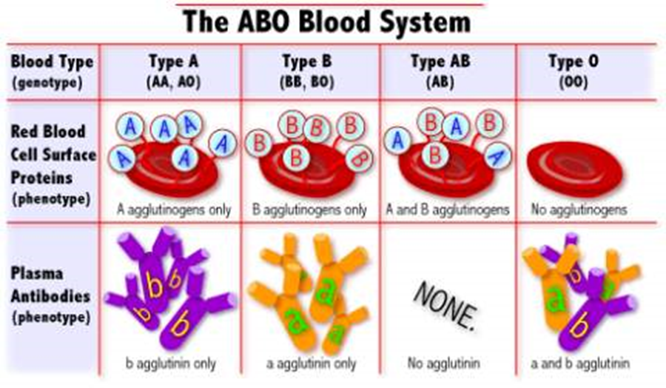
https://www.youtube.com/watch?v=xfZhb6lmxjk

Slide 6
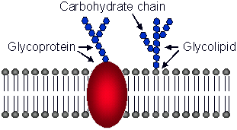
REMEMBER:
Membrane proteins with sugar attached that help cells recognize self
= _____________________________________
Glycoproteins

Slide 7
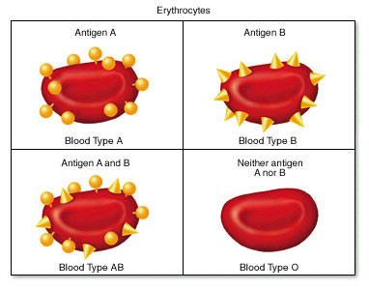
Anything foreign substance that your immune system recognizes as NOT “Self” is called an ________________.
Antigen

Slide 8
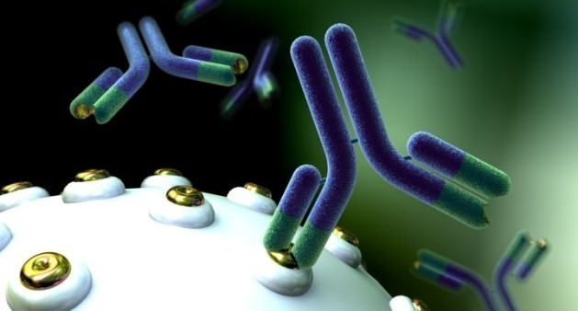
Antibodies
_________________________ are produced by white blood cells to keep out foreign antigens.

Slide 9
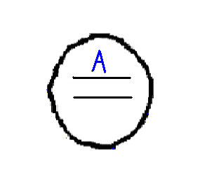
A Blood Types
An A allele tells
the cell to make
“A” glycoproteins and put on the cell’s surface

Slide 10
B Blood Type
B allele tells the cell to make “B” glycoproteins to put on the cell’s surface

Slide 11
O Blood Type
An O allele happens due to a broken gene that doesn’t make glycoproteins to put on cell’s surface.

Slide 12
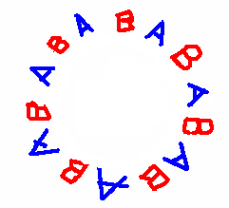
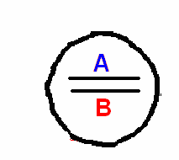
AB Blood Type
A and B are CODOMINANT
A cell with BOTH an A and a B allele makes both “A” and “B” glycoproteins to put on cell surface.

Slide 13
BLOOD TYPES & ALLELES
GENOTYPE | PHENOTYPE (BLOOD TYPE)
AA
AO
BB
BO
OO
AB
A
A
B
B
O
AB

Slide 14
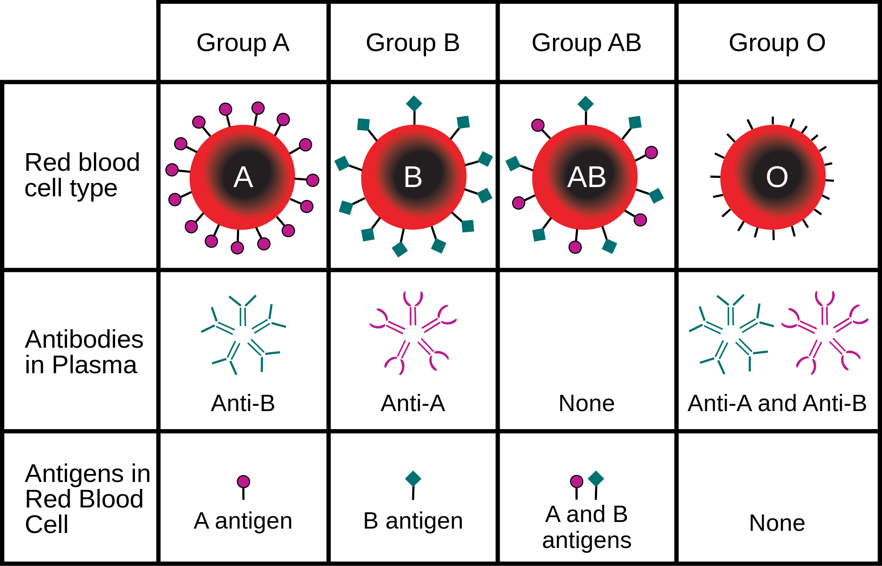

Slide 15
A person with “A” blood type…
Can donate to “A” blood type and “AB” blood type
Can receive blood from “A” blood type and “O” blood type
Make Anti-B antibodies
What would happen if an “A” blood type was given “B” blood?
Agglutination (Clumping)

Slide 16
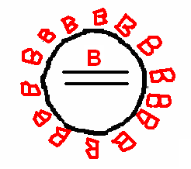
A person with “b” Blood Type
Can donate to “B” blood type and “AB” blood type
Can receive from “B” blood type and “O” blood type
Make Anti-A antibodies
What would happen if an “B” blood type was given “AB” blood?
Agglutination (Clumping)

Slide 17
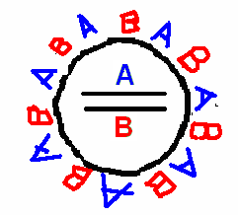
A person with “ab” Blood Type
Can donate to “AB” blood type and “AB” blood type
Can receive from EVERYONE
Makes no antibodies
UNIVERSAL RECIPIENT
What would happen if an “AB” blood type was given “O” blood?
Nothing, “AB” can receive all blood types

Slide 18
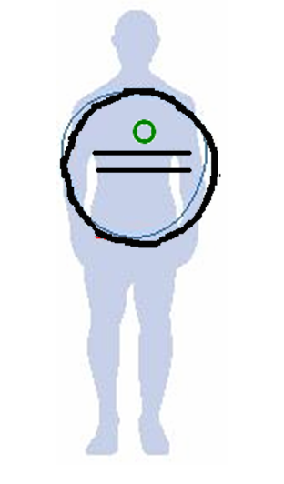
A person with “O” Blood Type
Nothing on surface to
recognize as “NOT SELF”
Can donate to EVERYONE
Can receive from only “O” blood types
Make both Anti-A and Anti-B antibodies
UNIVERSAL DONOR
What would happen if an “0” blood type was given “A” blood?
Agglutination (Clumping)

Slide 19
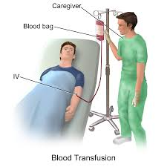
What happens if given the wrong blood?
IMMUNE SYSTEM ATTACK!

Slide 20
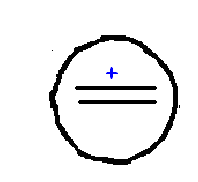
ABO is NOT the only System!
Rh System
Rh-Positive Vs. Rh-Negative

Slide 21
Rh-Positive (Rh+) Rh-Negative (Rh-)
Makes Rh glycoproteins and puts them on the cell’s surface
Due to a broken gene this person can’t make Rh glycoproteins

Slide 22
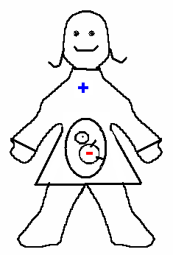
What’s the Big Deal?
NO PROBLEM!
Pregnancy
MOM is _____ & BABY is _____
MOM is _____ & BABY is ____

Slide 23
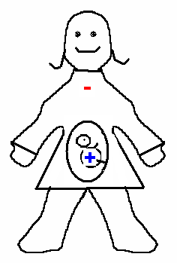
But when…
PROBLEM!
1st Rh (+) baby = Usually OK!
2nd Rh (+) baby = Can be attacked by mom’s immune system
Mom is _____
Baby is _____

Slide 24
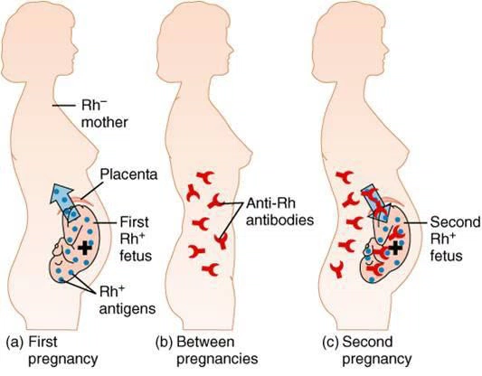
WhY?
During 1st pregnancy, some of the Rh(+) baby’s cells enter the mothers blood stream
During 2nd pregnancy, the mom’s immune system has built up anti-Rh antibodies.
Putting mom’s immune system
on ALERT
Mom’s immune system attacks
Rh(+) baby
http://www.topsixlist.com/2013/10/10/top-6-terrible-things-can-occur-during-pregnancy/

Slide 25
Practice
Create a blood cell for a person with “A” Blood Type
Create a Blood Cell for a person with “B” blood type
What happens if you add B antigens into the blood stream?
What happens if you add A antigens?
What happens if you add AB antigens?
What happens if you add 0 antigens?
What happens if you add B antigens?
What happens if you add A antigens?
What happens if you add AB antigens?
What happens if you add O antigens

